Slide 1
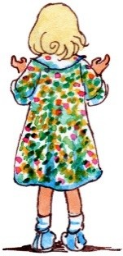
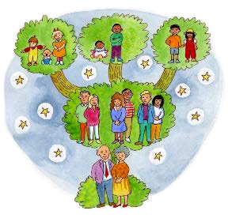
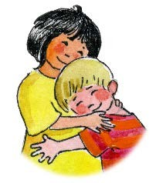
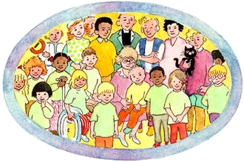
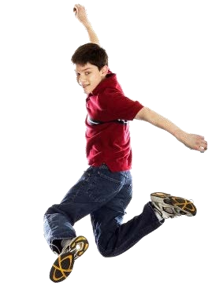
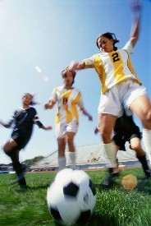
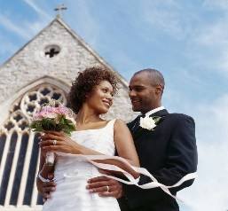
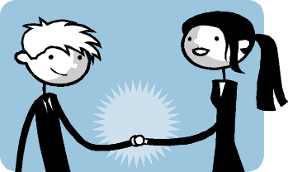
A Journey in LOVE
A developmental programme for children in the primary years
Nursery
Reception
Year One
Year Two
c
Year Three
Year Four Year Five
A Journey in Love - Home page
Year Six

Slide 2
St. Joseph’s Catholic Primary School
A Journey in Love
A developmental programme for primary school children
An RSE (Relationships and Sex Education) programme

Slide 3
RSE
Taught in a variety of ways:
PE
RE
PSHE
Science
Catholic ethos
Discrete RSE lessons

Slide 4
RSE in Catholic Schools
Catholic schools must deliver RSE in accordance with the teachings of the Catholic Church as well as following the guidance of the DfE
RSE is part of the mission of Catholic schools to educate the whole person

Slide 5
Effective RSE in Catholic Schools
In order for Catholic RSE to be fully effective it needs to:
Be faithful to the Church’s vision of human wholeness
Recognise the contemporary context in which we live today
Involve parents and carers
Equip children with the ability to make decisions about the right thing to do in particular circumstances
Promote respect and dignity
Be delivered in an age appropriate way which reflects the development of the child
Be cross-curricular
Be sensitive to the needs of individuals and recognise the mix of children from different sexual orientations, genders and family backgrounds

Slide 6
A Journey in Love
Approved and recommended by the Nottingham Diocese Follows the guidelines set out by the DfE and the Catholic Church
Based on the belief that we are made in the image and likeness of God
God is love (1 John 4:8)
The central message of the Christian faith and RSE teaching is love

Slide 7
A Journey in Love
An aspect of the mystery of love is taught in each year group
Reception: God loves each of us in our uniqueness
Year 1: We meet God’s love in our family
Year 2: We meet God’s love in the community
Year 3: How we live in love
Year 4: God loves us in our differences
Year 5: God loves me in my changing and development
Year 6: The wonder of God’s love in creating new life

Slide 8
A Journey in Love
In each year group, the programme consists of 5 areas:
Physical
Social
Emotional
Intellectual
Spiritual

Slide 9
A Journey in Love
Each area is broken down into:
Activities
Pause and Reflect
Prayer

Slide 10
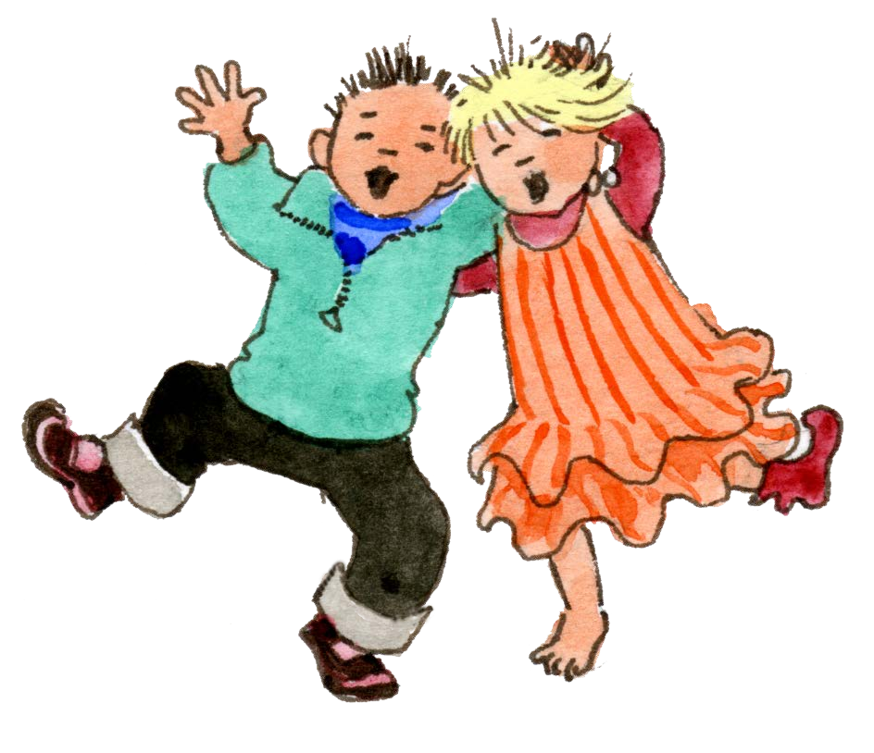
Reception
God loves each of us in our uniqueness
1 A Journey in Love - Reception

Slide 11
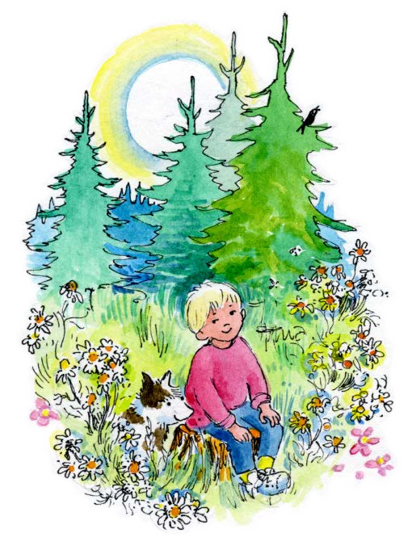
Objective
Know that there is no one more special than me.
Know that God made me and loves me as I am.
2 A Journey in Love - Reception

Slide 12
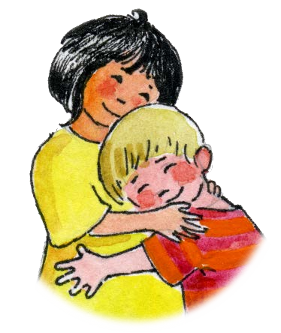
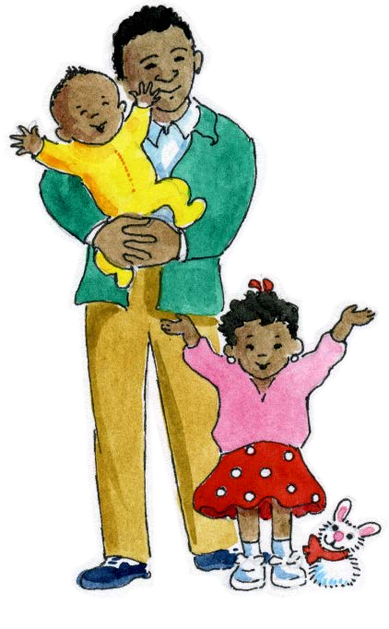
Keywords
God Unique Special Eyes | Hair Boy/Girl Hands Fingers Name | Family Love Womb Describe

Slide 13
Possible Activities for Reception
Close their eyes and describe themselves to the person next to them
Pick a name of another child out of a box and name one thing that person is good at
Say one thing they like about the person sitting next to them
Role play ‘The Good Samaritan’
Talk about children being special to God

Slide 14
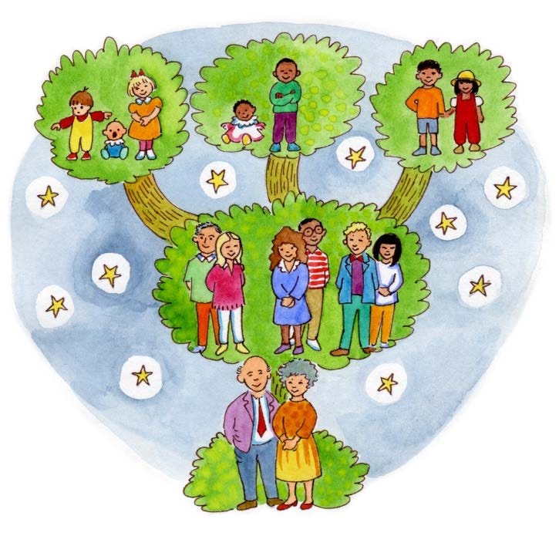
Year One
We meet God’s love in our family
1 A Journey in Love - Year 1

Slide 15
Objectives
Know that as we grow we are Loved by
our family.
Know that as we grow we are also loved by
God’s family.
2 A Journey in Love - Year 1

Slide 16
Keywords
God Special
Friend Different
Unique Important
3 A Journey in Love - Year 1

Slide 17
Possible Activities for Year 1
Talk about things you can do now that you could not do as a baby
Discuss how we help and care for others at home
Discuss happy and sad moments in your family
Bring in reminders of their Baptism
Talk about how we are members of God’s family

Slide 18
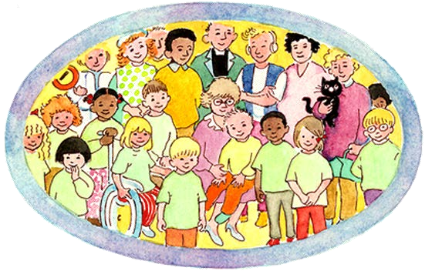
Year Two
We meet God’s love
in the community

Slide 19
Objectives
Know that the Church is God’s Family.
Know that I am
part of that
family too.

Slide 20
Keywords
God Community Belonging Family
Father/Mother Carer/Guardian Feelings Emotions

Slide 21
Possible Activities for Year 2
Discuss signs of belonging e.g. uniform, attendance, commitment
Meet with key community members e.g. priest, police officer, doctor
Share their own contributions to their communities
Role-play different scenarios in the communities to which they belong
Consider the advantages and disadvantages to being on their own

Slide 22
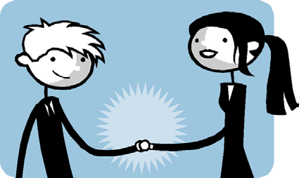
Year 3
How we live in love

Slide 23
Objectives
Understand what makes a good friend.
Know that God is our best friend.

Slide 24
Keywords
God
Community
Belonging
Family
Father/mother
Carer/guardian
Feelings
Emotions
Friends
Changing
Difference
Lonely
Alone
Forgiving

Slide 25
Possible Activities for Year 3
List the people who care for you at home, at school and in the community
Focus on ways of growing healthily and keeping safe
Look at photos of themselves taken over the years and notice changes
Look at ways of making and keeping a friend
Read a story highlighting how a friend feels when they are not helped
Discuss the differences between being alone and being lonely
Consider the meaning of ‘personal space’
Share a sign of peace and friendship

Slide 26
Year Four
God loves us in our differences

Slide 27
Objectives
Know that God has made us different from one another.
Know that God loves us in our differences.

Slide 28
Keywords
God, Gifts, Talents,
Difference, Development, Change,
Male and female body parts,
Conflict, Appreciate, Celebrate, Achievement, Sensitivity, Respect.

Slide 29
Possible Activities for Year 4
Notice the physical differences in class; notice that each teacher is unique and accepts themselves and others as they are
Look simply at the development of the baby in the womb
Think about things they are good at and like about themselves; think about their personal qualities; write down something they like about their friend and share it with them
Identify different emotions; categorise happy and sad feelings

Slide 30
Year Five
God loves me in my changing
and development

Slide 31
Objectives
* Know that as we grow we will become different in our…
…bodies
…feelings
…love of God

Slide 32
Keywords
God Sensitivity Puberty Presence Celebrate
External Internal Change Develop Ovulation

Slide 33
Possible Activities for Year 5
Identify and celebrate the ways they have changed since birth
Discuss the external and internal changes which happen to boys and girls in puberty
Recognise that behaviour changes as they grow up
Reflect on ways to become more sensitive to the emotional development of themselves and others
Share with each other and celebrate the wonder of change

Slide 34
Year Six
The wonder of God’s love in creating new life

Slide 35
Objectives
Know that we are made to love and to be loved.
Learn the proper ways in which we show our love for one another and for God.

Slide 36
Keywords
God Christian Appropriate Dignity Sexuality Intercourse Fiancé
Fallopian Conceive Relationship Uterus Cervix Marriage

Slide 37
Possible Activities for Year 6
Explain how human life is conceived
Look at illustrations of the organs of the human body, including male and female reproductive organs
Compile a list of the signs of love expressed in those around us
Reflect on the different degrees of friendship that exists
Understand that God causes new life to begin through the love that parents have for each other

Slide 38
A Journey in Love
All of this is taught through an appreciation of the children’s own dignity and worth as children of God
It is appropriate to their age, development and understanding
It contributes to the development of the whole child – intellectually, socially, emotionally, physically and spiritually

Slide 39
A Journey in Love
Any questions/concerns:Please email or call the office and I will endeavour to answer your questions.
Parents have the right to withdraw their child from RSE (but not from the parts included in the Science National Curriculum which is statutory) after discussion with the headteacher
Thank you for your continued support

